Slide 1
TOPIC A:
DATABASES
LESSON A-14
DIFFERENT DATABASE MODELS

Slide 2
AGENDA
Relational Database Model
Object-Oriented Model
Network Model
Spatial Databases
Multi-dimensional Databases
Data Definition
Data Manipulation
Data Integrity
NOTE!
Have a way to take notes available for this lesson

Slide 3

THE WARM UP QUESTION
What are two ways that databases can protect user data, and how do they work?

Slide 4
THE WARM UP ANSWER
Encryption – scramble data using a key to protect it
Access Control – accessing data only with correct permissions in the organization
Anonymization – remove personally identifying information
Data minimization – collect only what is explicitly necessary
Audits – detect unauthorized use or access of data

Slide 5
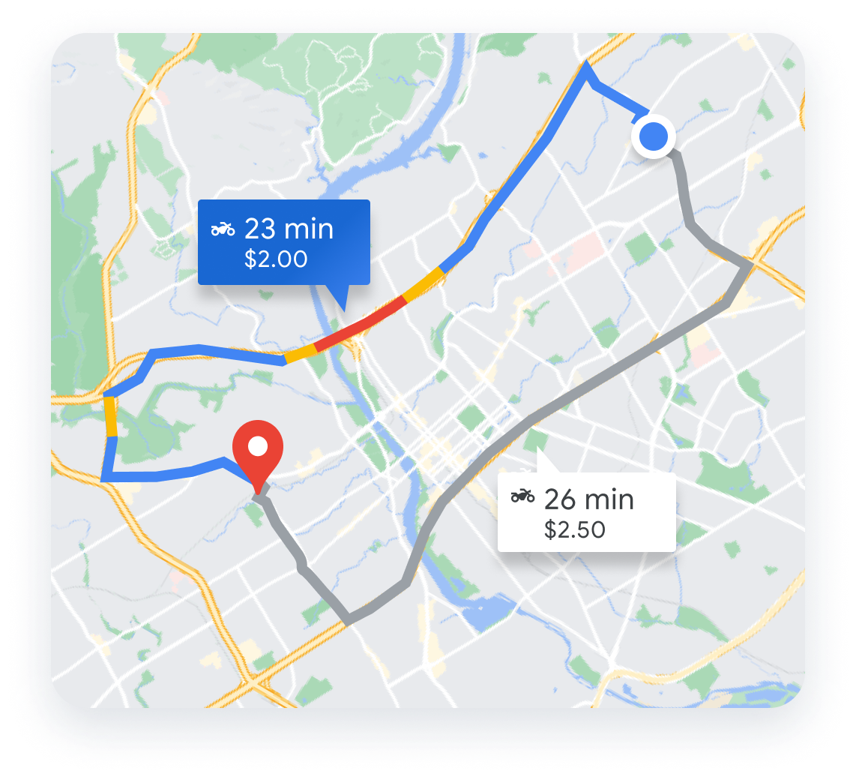
DATA
If you were building Google Maps, would a standard ‘Excel’ style table be a good way to store the location of every road on Earth?
Why or why not?

Slide 6
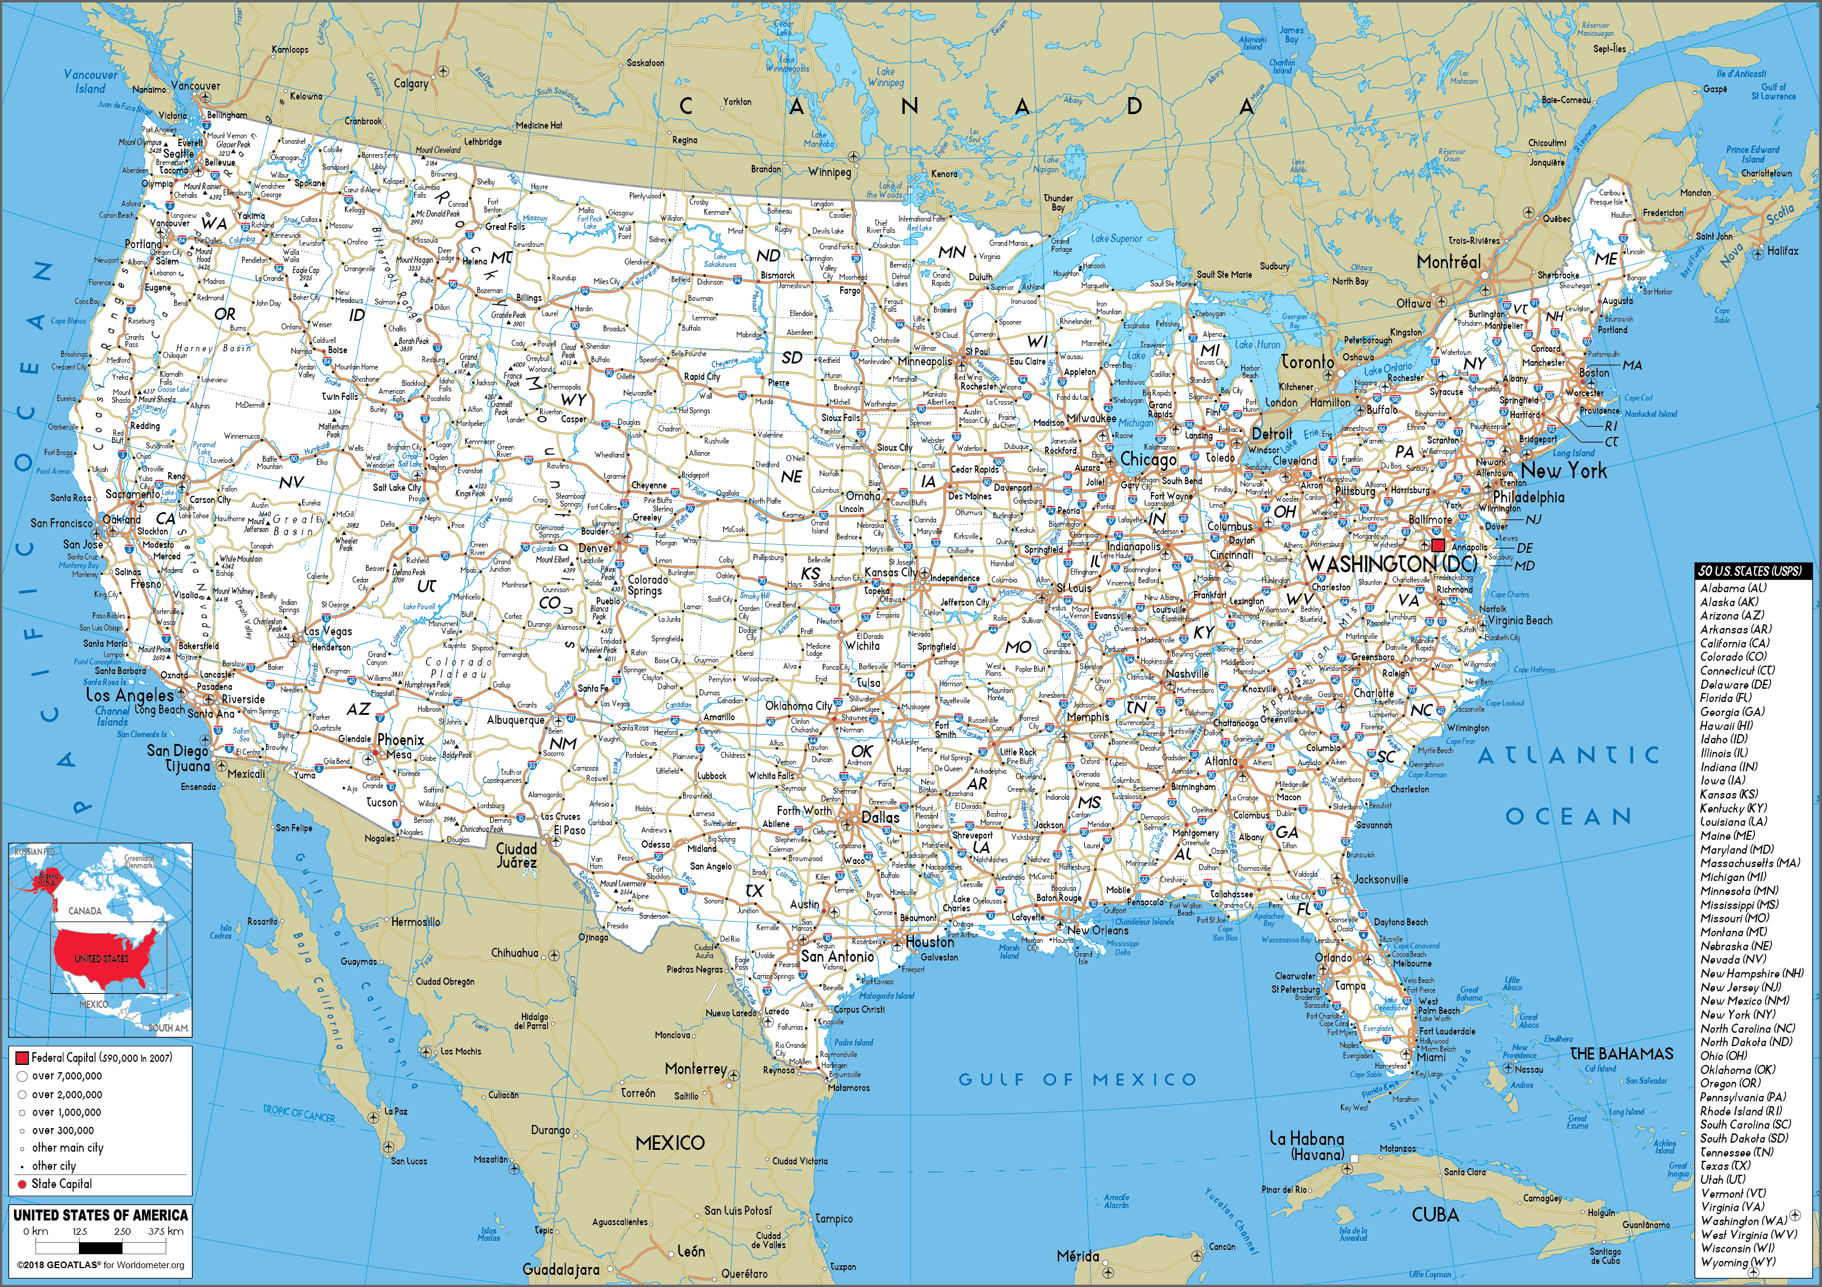
MODELS
Google Maps is a model of our real world system of roads
A map isn’t the same as the territory itself
Is a database record the same as the person or object it describes?
How does the schema limit what we can know about the data?

Slide 7

MODELS
Does the way we model data limit our knowledge of the world?
If a database for a hospital allows ‘Male’ or ‘Female’ in a dropdown, does the data accurately represent reality?

Slide 8
MODELS
We could argue that the database schema acts as a filter for truth
What’s another example where a rigid database might ‘miss’ the nuances of the real world

Slide 9
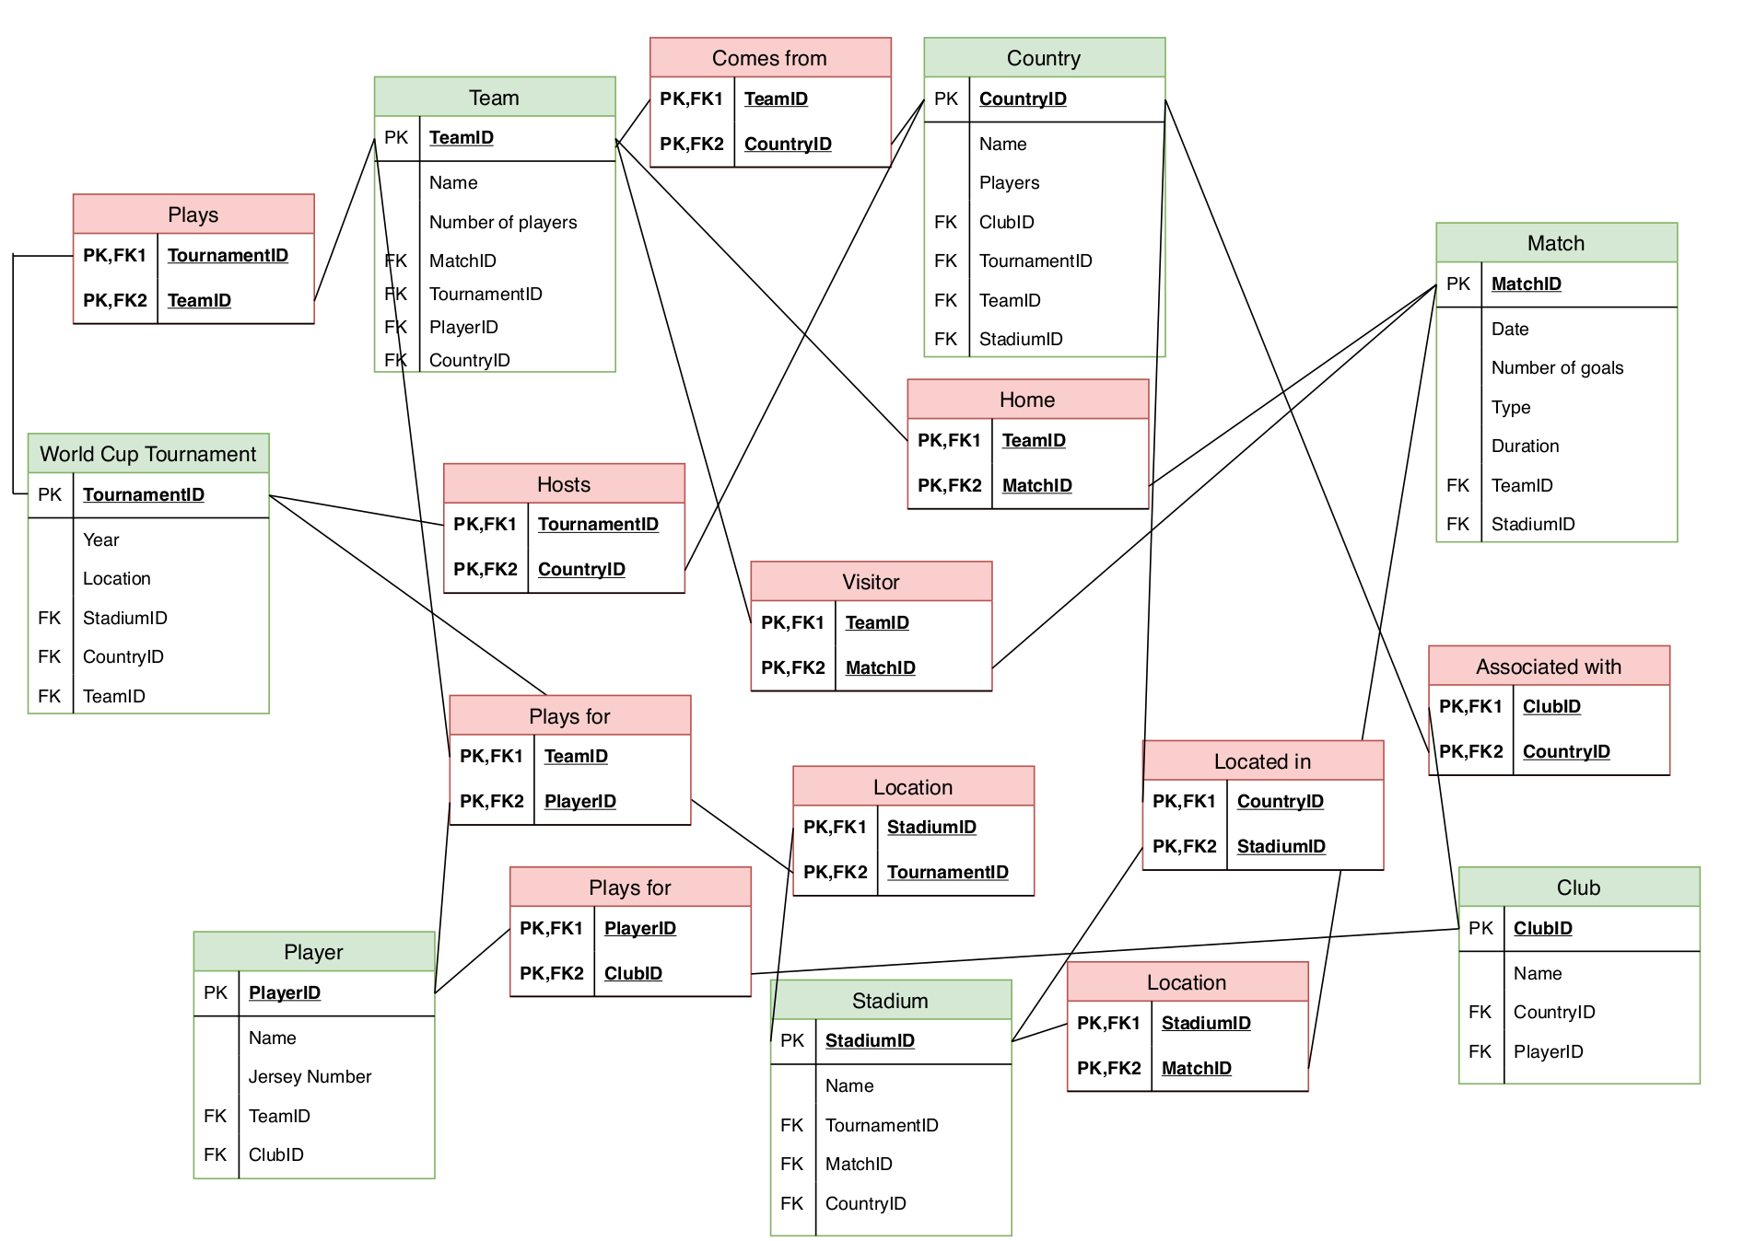
RDBMS
Everything we’ve studied thus far has been from the Relational Database Model
Data is organized into tables
Unique Primary Keys and Foreign Keys
Strict schema/structure

Slide 10
RDBMS
Example: A school management system
Teachers, students, classes, assignments, etc.
How do we connect tables to each other in a RDBMS?

Slide 11

THE WALL
Imagine that we’re creating a database for a car repair shop
Each car has multiple parts
Each part may have multiple attributes it shares with other parts, so those need to be their own table as well
How do we get the information from multiple parts together (or just combining any tables in SQL?)

Slide 12
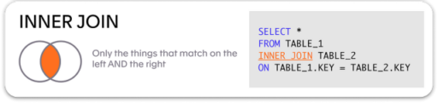
THE WALL
Having to do multiple joins all at once can be very costly
Takes a lot of time to program
Takes a lot of time to run
Is very technically difficult to understand

Slide 13
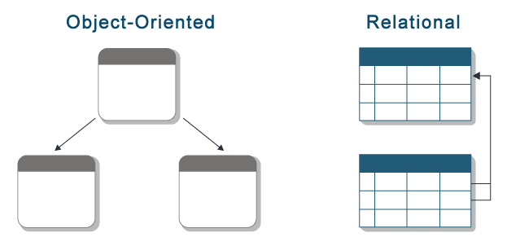
OBJECTED ORIENTED DATABASE MANAGEMENT SYSTEMS
This is the ‘programmer’s solution’ to some of the issues with an RDBMS
Data is stored as objects (states & behaviors)
No translation is needed between code and database
Supports inheritance
SavingsAccount can inherit properties from Account

Slide 14
OBJECTED ORIENTED DATABASE MANAGEMENT SYSTEMS
Let’s look at why a developer might prefer this
# Follow me: Creating a 'Student' Object class Student: def __init__(self, name, id): self.name = name self.id = id self.grades = [] # A list inside an object! def add_grade(self, g): self.grades.append(g) s1 = Student("Alara", "IB123") s1.add_grade(95) # Discussion: In a Relational DB, 'grades' would need a # whole separate table. In OO, it's just part of the object.

Slide 15
OBJECTED ORIENTED DATABASE MANAGEMENT SYSTEMS
So, what seems easier to write code for?
RDBMS or OODBMS?
Why?

Slide 16
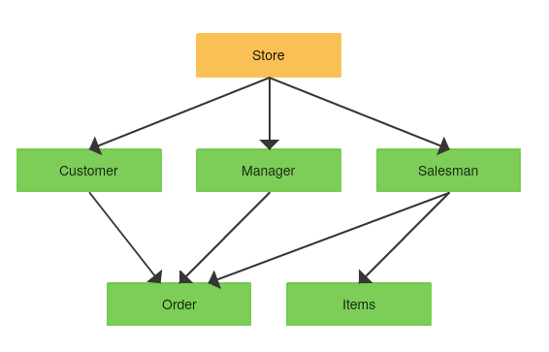
NETWORK MODEL
The network model acts like a parent-child structure, but where children may have multiple parents
Pointers are used to create a web of records

Slide 17
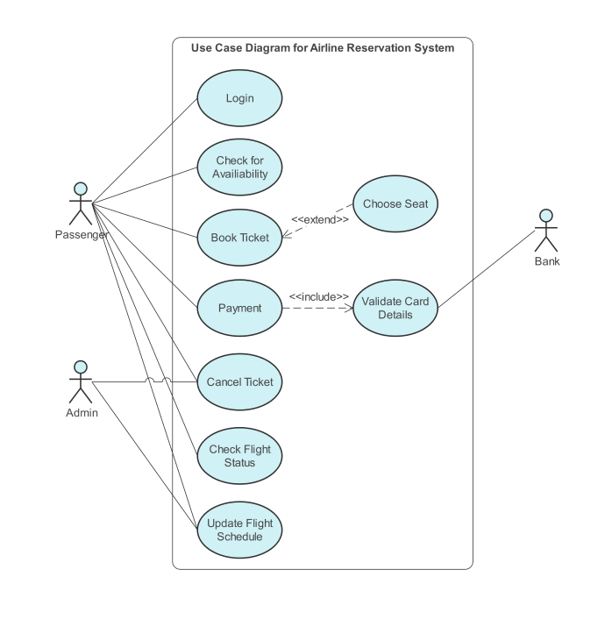
NETWORK MODEL
The network model is used in the Legacy Airline Reservation systems (SABRE)
It’s like a physical map where roads connect to cities
It’s fast to follow a path, but if you want to add a new city you have to redraw the roads

Slide 18
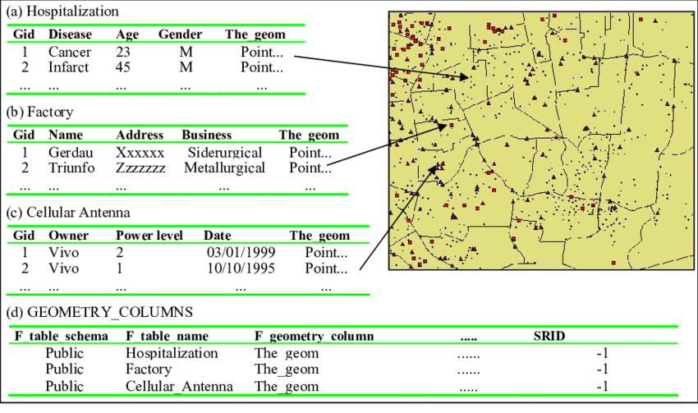
SPATIAL DATABASES
Speaking of physical maps, a spatial database is used to do physical, geographic mapping
It stores either 2D or 3D data using points, lines, and polygons

Slide 19
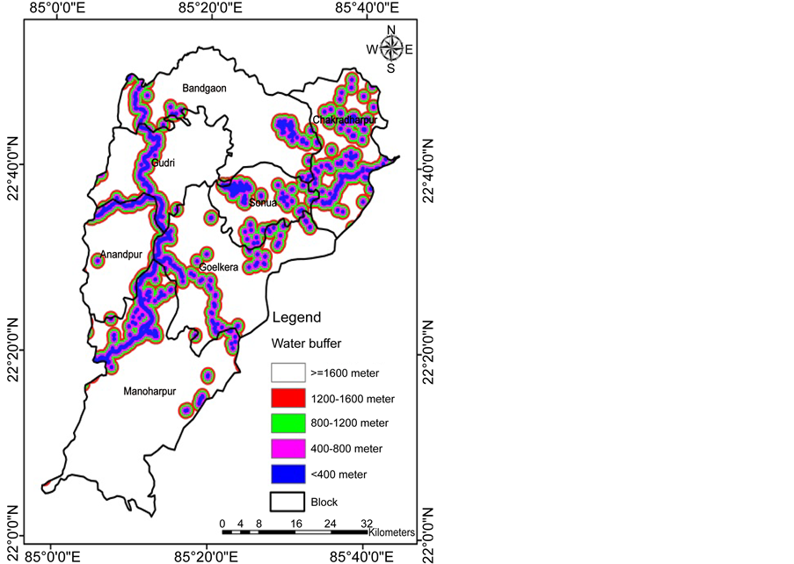
SPATIAL DATABASES
Example: Used by the UN to track refugee migration
Example: Used by the WHO to track disease outbreaks

Slide 20
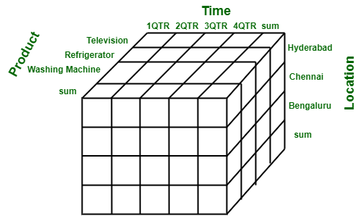
MULTI-DIMENSIONAL DATABASES
Multi-dimensional databases are used for Online Analytical Processing
Dimensions might include Time, Geography, Product, or Sales
We use this to extract useful information from our collected data
The diagram to the right shows a data cube, a visual representation of this

Slide 21
MULTI-DIMENSIONAL DATABASES
Example: A CEO looks at a slice of the data cube to see why iPhone sales dropped in Germany during July
Why is a 2D table bad for this?

Slide 22
EVALUATION
What type of database discussed today is best for a tech startup that is constantly changing its app features? Why?

Slide 23
EVALUATION
RDBMS: Rigid – you must define columns/types before you save anything
OODBMS: Flexible – you define classes, and you can add new attributes to the class at any time
With this said, OODBMS would be better for the tech startup

Slide 24
EVALUATION
How is data manipulated in a RDBMS vs an OODBMS?

Slide 25
EVALUATION
RDBMS: Uses SQL – structured query language. Shared between all relational databases with small changes.
OODBMS: Uses a programming language (like Python or Java). Great for developers, but harder for your average joe to learn.

Slide 26
EVALUATION
Which type of database, RDBMS or OODBMS, do you think has stronger Data Integrity?

Slide 27
EVALUATION
RDBMS: Uses ACID Properties. Hard to lose or break data because DB manages the rules
OODBMS: Programmer is responsible for the rules. If the programmer makes an oopsie in the class, the data becomes a mess

Slide 28
EVALUATION
RDBMS:
Safety
OODBMS
Speed
Flexibility

Slide 29
LAB QUESTION
A global weather agency uses a spatial database to track hurricane paths. Explain why a spatial database is more appropriate here than a standard relational database. [3]

Slide 30

VOCAB TO REMEMBER
Relational Database (RDBMS)
Object Oriented Database (OODBMS)
Network Model
Spatial Database
Multi-dimensional Databases
Data Cube

